Slide 1

Congratulations!
To ALL
St. Vincent’s
2012
Graduates!

Slide 2
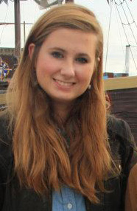
Molly Eileen Helie
Graduating From
Carver Center
for the Arts & Technology
Headed For
Loyola
University
New Orleans, LA
To Study
Fine Arts & Religious Studies

Slide 3
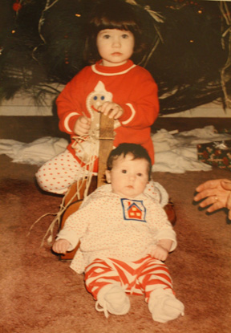
Molly Eileen Helie

Slide 4


Molly Eileen Helie

Slide 5
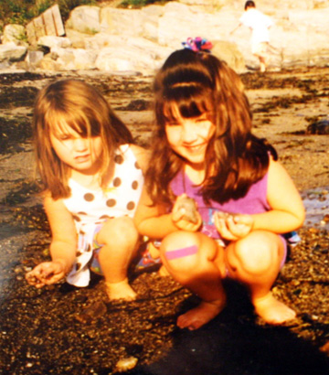
Molly Eileen Helie

Slide 6
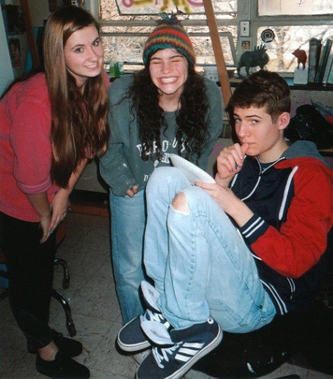
Molly Eileen Helie

Slide 7
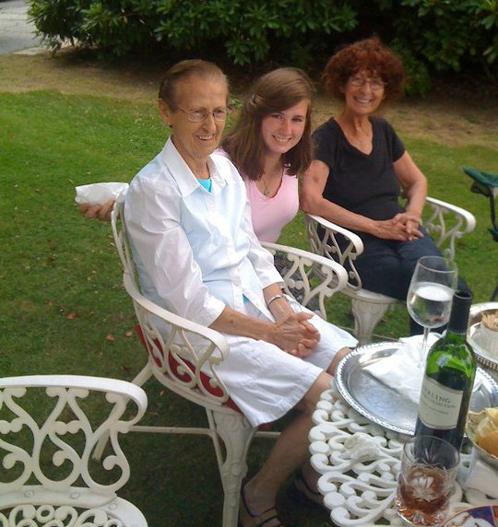
Molly Eileen Helie

Slide 8
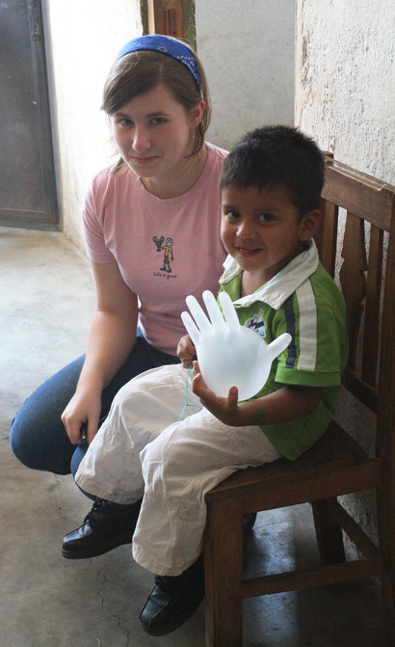
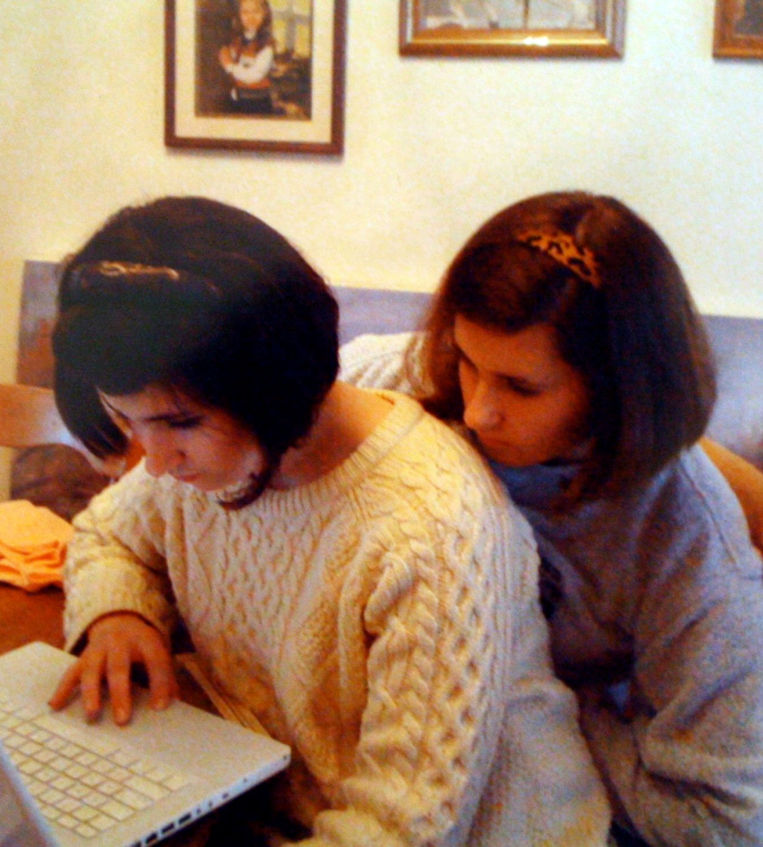
Molly Eileen Helie

Slide 9
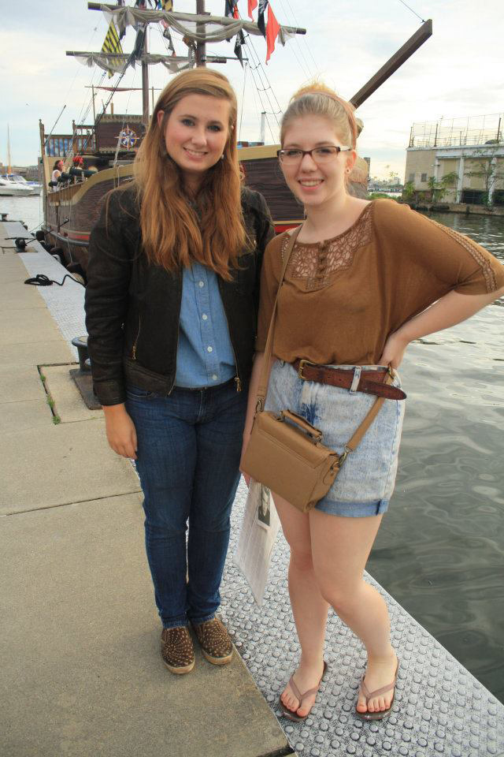
Molly Eileen Helie

Slide 10
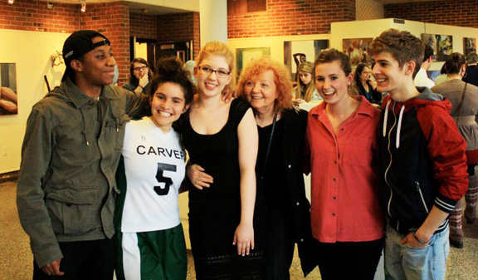
Molly Eileen Helie

Slide 11
Molly Eileen Helie
Graduating From
Carver Center
for the Arts & Technology
Headed For
Loyola
University
New Orleans, LA
To Study
Fine Arts & Religious Studies

Slide 12
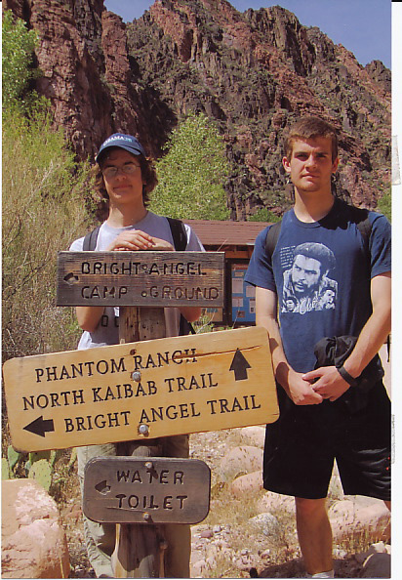
John Kevin Beck
Graduating From
Baltimore
Polytechnic
High School
Headed For
Penn State
University
To Study
Aerospace
Engineering

Slide 13
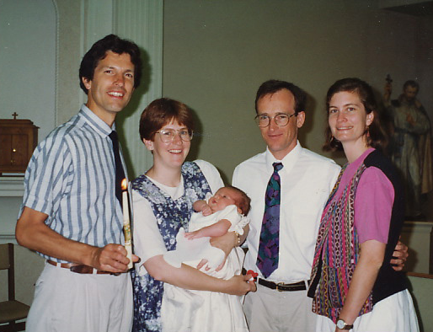
John Kevin Beck

Slide 14
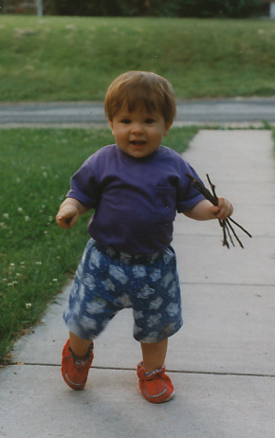
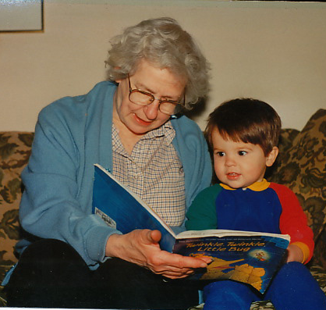
John Kevin Beck

Slide 15
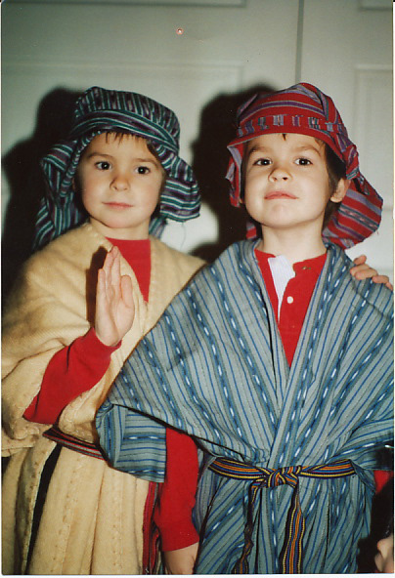
John Kevin Beck

Slide 16
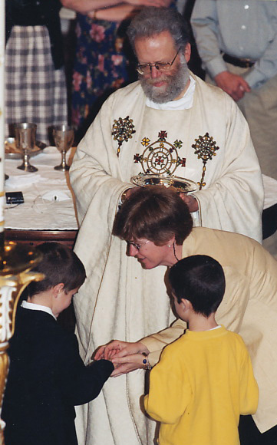
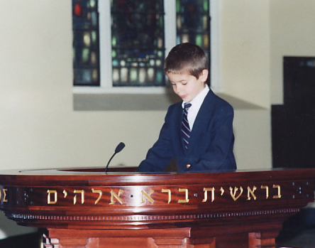
John Kevin Beck

Slide 17
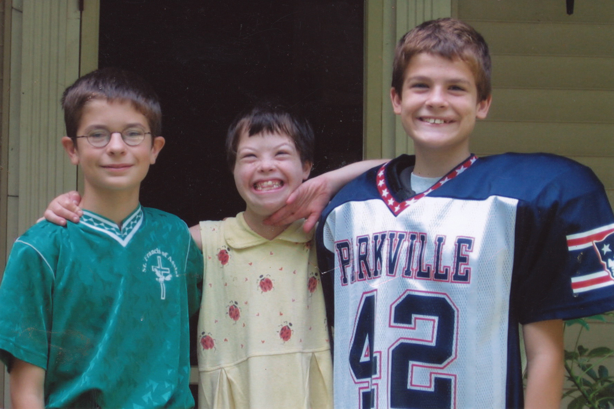
John Kevin Beck

Slide 18
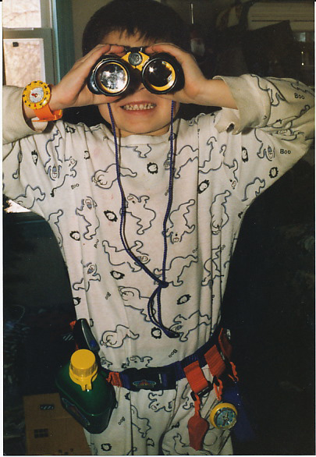
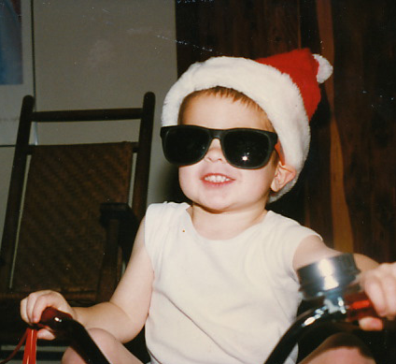
John Kevin Beck

Slide 19
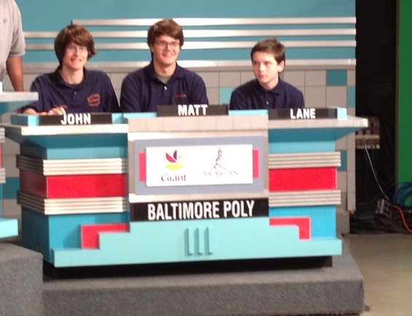
John Kevin Beck

Slide 20
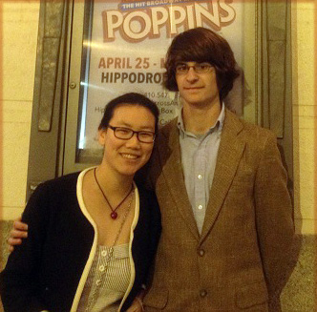
John Kevin Beck

Slide 21
John Kevin Beck

Slide 22
John Kevin Beck
Graduating From
Baltimore
Polytechnic
High School
Headed For
Penn State
To Study
AerospaceEngineering

Slide 23
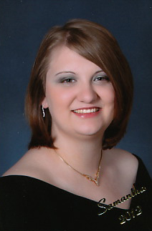
Samantha
Robinson
Graduating From
Strawbridge
High School
College Plans
In the Future

Slide 24
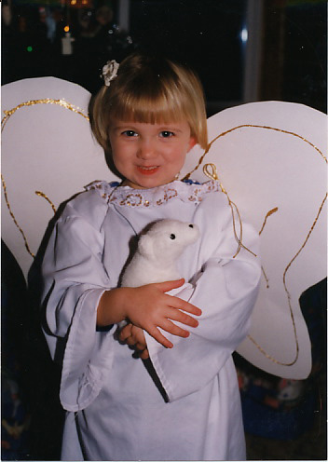
Samantha
Robinson

Slide 25
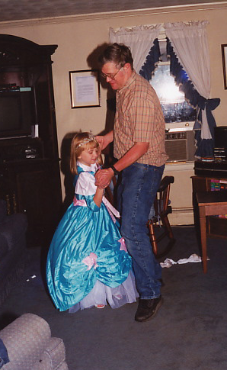
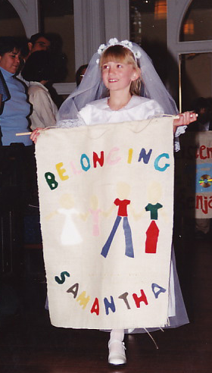
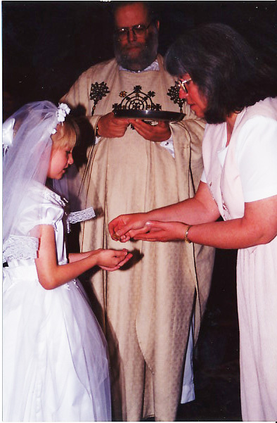
Samantha
Robinson

Slide 26
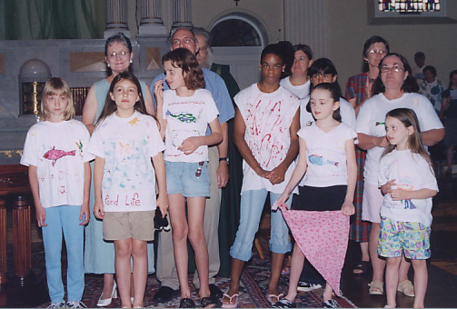
Samantha
Robinson

Slide 27

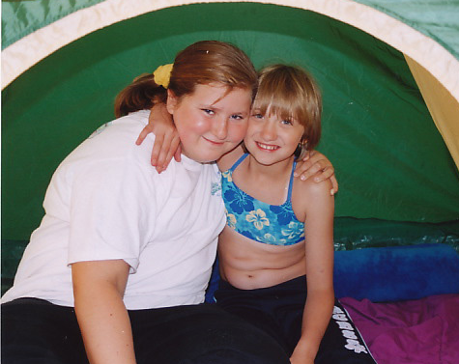
Samantha
Robinson

Slide 28
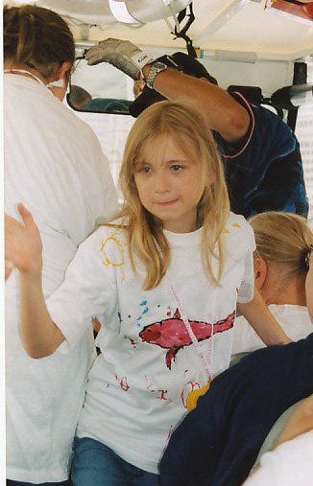
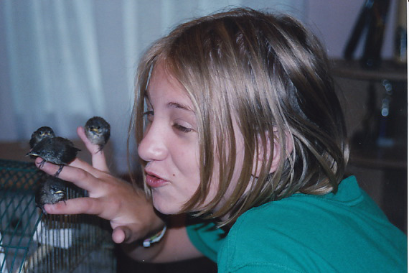
Samantha
Robinson

Slide 29

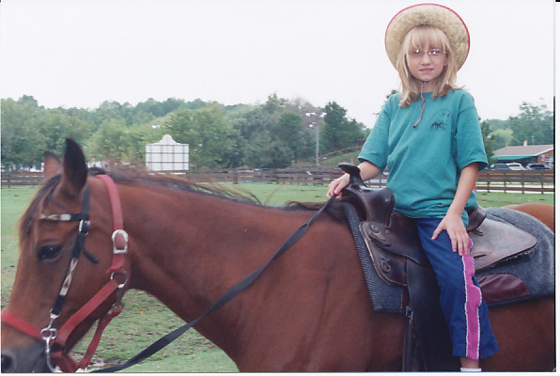
Samantha
Robinson

Slide 30

Samantha
Robinson

Slide 31
Samantha
Robinson
Graduating From
Strawbridge
High School
College Plans
In the Future

Slide 32
We Also Recognize
HANNAH POTTS
Who was Homeschooled
And is heading to
Baltimore County
Community College/
Towson University
To study
Music Performance

Slide 33
Congratulations!
To ALL
St. Vincent’s
2012
Graduates!

Slide 34
Congratulations!
Our Prayers are with
you!

